Slide 1
Programming Project Robot in a park
Manasik Kamal Aldeen

Slide 2
Project Idea: Robot in a Park Distributing Water
The project involves a robot located in a park with the task of distributing water to those who want it. Description:
Interaction: The robot approaches each person in the park and asks if they would like some water.
If the answer is "Yes", the robot provides them with water.
If the answer is "No", the robot apologizes for the inconvenience.

Slide 3
If the answer is anything other than "Yes" or "No",
the robot apologizes for not understanding and asks them to reply with either "Yes" or "No". Timing: To avoid being bothersome, the robot waits for a short period of time (e.g., three hours) before asking the people again.

Slide 4
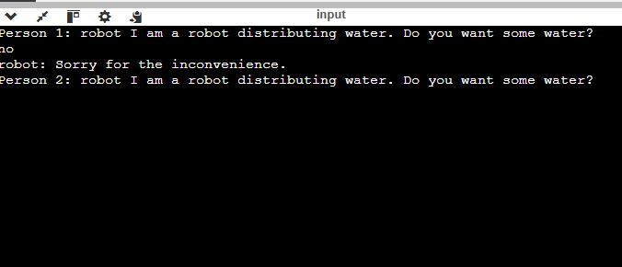
In this scenario
the robot asks the first person if they want some water. The person says "No," so the robot apologizes for bothering them and moves on to the next person to ask the same question.

Slide 5
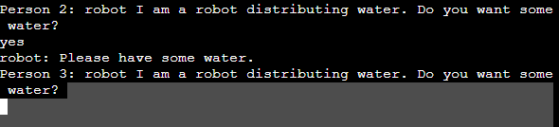
In this scenario,
the robot asks the first person if they want some water. The person says "Yes," so the robot gives them the water and moves on to the next person to ask the same question.

Slide 6
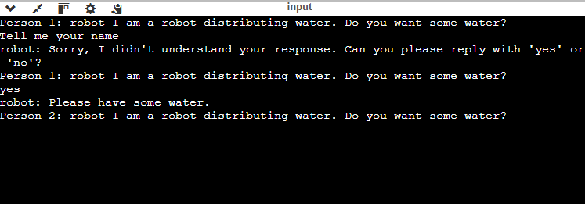
In this scenario
the robot asks the first person if they want some water. The person replies with "Tell me your name." The robot responds, "Sorry, I didn't understand. Can you please answer with 'yes' or 'no'?" The person then says "Yes," so the robot gives them the water.

